Slide 1





C
Birmingham Family Hubs
Offer 2025 – 2026

Slide 2


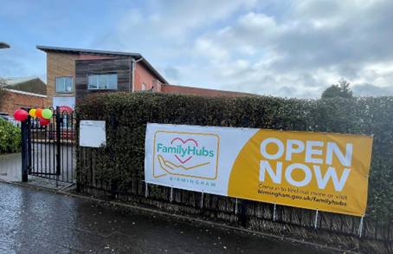


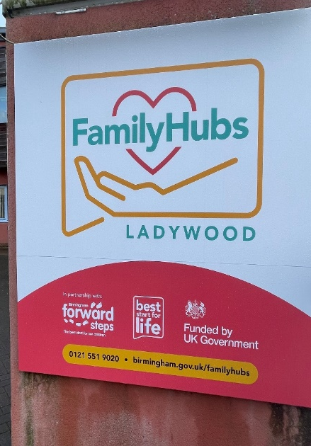








Birmingham Family Hubs Programme
The Birmingham Family Hubs and Start for Life Programme has funded been by central government to improve access to services for all families, children and young adults in Birmingham that need support during their child's journey from 0 – 19 years / 25 years with SEND. The programme will improve access, connections between families, professional and service providers and to put relationships at the heart of family support
There are ten physical Family Hubs locations across Birmingham, where you will be able to go to get advice and practical support for you and your family.
Locality | Family Hub
Hodge Hill | Main site Dyson Children’s Centre Satellite Kitts Green Children's Centre
Ladywood | Main site Soho Children’s Centre Satellite Ladywood Children’s Centre
Hall Green | Main site St Pauls Children’s Centre Satellite Springfield Children’s Centre
Northfield | Frankley Children’s Centre
Erdington | Main site Lakeside Children’s Centre Satellite Castle Vale Children’s Centre
Selly Oak | Chinnbrook Children’s Centre
Yardley | Fox Hollies Children’s Centre
Edgbaston | Doddington Children’s Centre
Perry Barr | Main site Rookery Children’s Centre Satellite Lime Tree Children’s Centre
Sutton | Holland House Children’s Centre in partnership with Our Place Support

Slide 3
4 of the 24 service expectations are funded by the Programme the other 20 are reliant upon partnerships and system changes to work together i.e. co location / co delivery of services in the Family Hub / Network (see below funded offer slides) For each of the 24 services the Programme Guide outlines ‘minimum expectations’ and ‘Go Further Expectations’ to work towards for each Family Hubs, these are reviewed and RAG rated each Quarter.
The Family Hub and Best Start for Life Offer in your local area
Activities for children aged 0-5
Birth Registration
Debt and Welfare Advice
Domestic Abuse
Early Language and Home Learning Environment
Early Childhood Education and Care (ECEC) and financial support (Tax-Free Childcare, Universal Credit childcare)
Health visiting 0-5
Housing
Infant Feeding Programme
Intensive targeted family support services
Local authority 0-19 public health services, based on local needs assessments
Mental health services
Midwifery / Maternity
Nutrition and Weight Management
Oral Health Improvement
Parent-Infant Relationships and Perinatal Mental Health Support
Parenting Support
Reducing Parental Conflict
SEND support and services
Stop Smoking Support
Substance (alcohol/drug) misuse support
Support for Separating or Separated Parents
Youth Justice Services
Youth Services - Universal and Targeted

Slide 4
Funded Offer 2025 – 2026 HLE (Communication & Language 2- 4 years)
Provider | Home Learning Environment (HLE) Service | Continuation / New
Barnardos | Making it REAL (MiR) project: Practitioners will identify families requiring a home visit and literacy events. Each identified family is expected to receive at least four home visits from practitioners | Continuation
Barnardos | Special Approach to Making it REAL is a project aimed at parents or carer of a child who may have additional needs or a disability under 5 years old and supports children’s social communication which provides a base for the development of language and literacy. | Extension of REAL offer
Booktrust | Libraries and Book Trust - This collaboration between Book Trust and Libraries is designed to enhance the enjoyment of reading, which has a positive impact on school life. The initiative will work with Stay and Plays across the city as well as support families in temporary accommodation by encouraging them to use venues like Libraries and Family Hubs to understand the importance of early childhood reading for school readiness. | Continuation
NSPCC | NSPCC Look, Say, Sing, Play flashcards and leaflets for 0–2-year-olds is based on fun and easy brain-building tips for parents to have high quality interactions with their baby as part of their daily routine and help parents bond. | Continuation
National Literacy Trust | National Literacy Trust - Early Words Together is a DfE approved programme that aims to support the communication, language, and early literacy of young children age 3-4 through evidence-based activities which lead to improvements in their home learning environments. | New
TBC | HLE Practitioner will work alongside the peri-natal mental health team to support parents learning with children in temporary accommodation - this role would also support EEE take-up. | New
BCC EY | Practice Officer will support connectivity across the HLE, Early Years and Family Hubs. | New
‘Easy Peasy’ and ‘50 Things to do before your child is 5’; digital apps will continue but not funded by the Family Hub Programme and Early Talk Boost will continue as part of BAU but will not be funded in 25 – 26 by the Family Hub Programme

Slide 5
Funded Offer 2025 – 2026 Parenting (0-2 years*)
Provider | Parenting Service | Continuation / New
Solihull Approach | Solihull Approach training, licence, manuals and resources | Continuation
Spurgeons | Footsteps & Stepping Stones Parenting Programmes – SEND | Continuation
Barnardos | EPEC Programme, Evidence based Parenting Programme (Empowering Parents Empowering Communities) | Continuation
BVSC / VS Early Help Leads | Peer Support / Community Connectors, Outreach into the community focus on promoting the Family Hub offer and to target the hard to reach, seldom heard communities and build trust | Continuation
Approachable Parenting | Approachable Parenting - 5 Pillars of Parenting programme | Continuation
BCT | Parenting Coordinator and Participation Engagement Officer BCT - to deliver Solihull Approach and Family Foundations & provide co-ordination of local offer | Continuation
Parenting Apart | Parenting Apart Programme - train 12 practitioners within The Parenting Apart Programme, 12-month license, Training Manuals, Certificates of attendance, Bi-monthly Managerial Meetings, 3 x Reflective Supervision Sessions with Clinical Psychologist, Evaluation of outcomes of the training | New
*funding must be invested in services for families with babies aged 0–2 and must promote bonding and attachment, with a focus on sensitive and attuned parenting, laying strong foundations for both socio-emotional and cognitive development
REFER TO THE PARENTING DIRECTORY: A DESCRIPTIVE GUIDE TO ALL ONLINE AND IN PERSON PARENTING COURSES 0-19 OFFERED BY FAMILY HUBS BEST START FOR LIFE AND BIRMINGHAM CHILDREN’S TRUST

Slide 6
Funded Offer 2025 – 2026 Perinatal Mental Health
Provider | Service | Continuation / New
Rees Foundation | Care Experienced Parent Support - Rees Foundation 1-1 & group support / programmes / activities for care experienced parents | Continuation
Approachable Parenting | The Rahma Project Chit, Chat, Chai – well being workshops | Continuation
BCT | BCT Outreach Worker - Care Experienced Parent support in the community including in Family Hubs | Continuation
Born to Bond | Born to Bond Training - delivery of 2 day core training | Continuation
Birmingham Women's Hospital - FTB | Training and Workforce co-ordinator - Training co-ordination and consolidation support | Continuation
Birmingham Women's Hospital - FTB | Clinical Supervision - to support training consolidation and delivery for P&P workforce | New
Birmingham Women's Hospital - FTB | WIFWU training - Warwick Infant & Well - Being Unit) - offer PIIOS and IMHOL training x 8 practitioners | New
Acacia | Acacia Dad Peer Support Worker - Dad Peer Support Groups | Continuation
Maternity Engagement | MEC Peer Support for black women in Ladywood and Perry Barr | Continuation
Noah's Star | Noah's Star - Peer support for parents with a premature / neo natal child and support to the siblings | Continuation

Slide 7
Funded Offer 2025 – 2026 Perinatal Mental Health continued
Provider | Service | Continuation / New
Birmingham Women's Hospital - FTB | PAIRS - continuation of PAIRS Perinatal Offer | Continuation
Compassionate Minds | Compassionate Minds training - additional cohorts planned | Continuation
Birmingham Women's Hospital – LMNS | Maternity Navigators - to ensure ongoing personalised support to pregnant women and families who experience inequalities and language barriers – this offer is city wide | Continuation
Training provider - BCHC | Restorative Supervision - for HV's | Continuation
Birmingham Womens Hosptial - FTB | Subject Matter consultancy support - P&P workstream leadership SME / Assistant | New - reinstating was stopped in Q1 24
Birmingham Women's Hospital - FTB / Parent Infant Foundations | PAIR Strategy | Continuation
There is a balance of around 200K which is yet to be committed and will be subject to DFE approval
Work will continue to develop a BSOL Perinatal Mental Heath and Parent Infant Relationships Strategy and implementation of this

Slide 8
Funded Offer 2025 – 2026 Infant Feeding
Provider | Service | Continuation / New
Breastfeeding Network | Breastfeeding Network Peer Support | Continuation
Maternity Hospitals | Additional Infant Feeding staff on maternity wards | Continuation
TBC | Training on infant feeding pathways/support for the wider system e.g. early help, social care | New
TBC | IF Resource Translation | New
TBC | Training and support (including policy development) for Breastfeeding friendly work places and businesses | New
Work will continue to implement the BSOL Infant Feeding Strategy that was devised following stakeholder engagement in 2024 – 2025

Slide 9



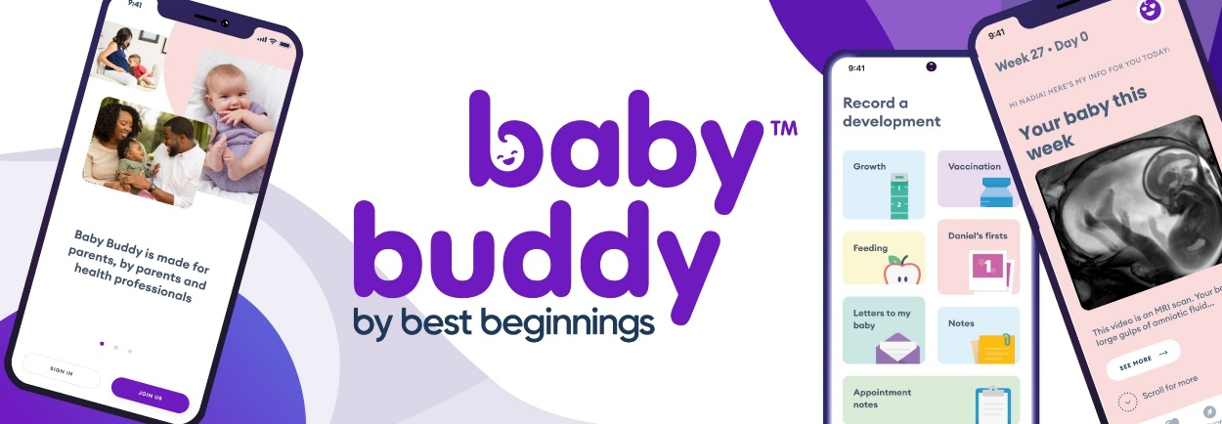
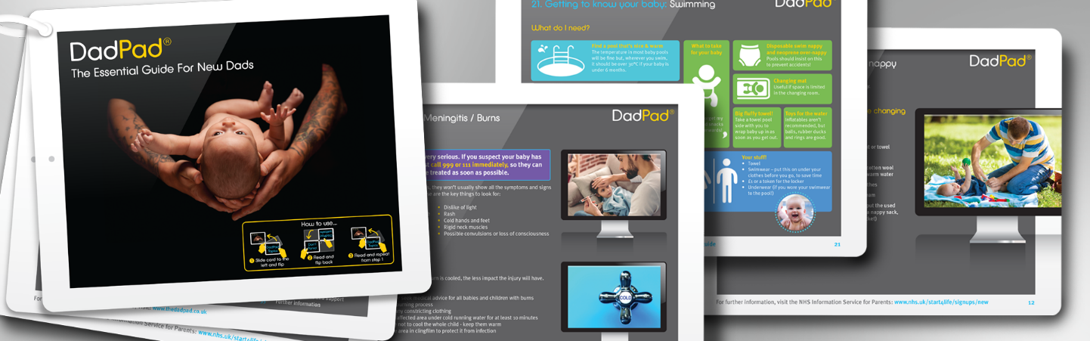
Digital Apps
Birmingham Family Hubs have partnered with Essential Parent, to create an App containing a wide range of expert-led, evidence-based written and video content. The content starts with advice on getting pregnant and continues up to children aged 19 and can be accessed in 75 community languages
50 Things To Do is a menu of fun and educational activities for parents and carers to do with their children before they are five.
Easy Peasy tips is full of advice, and activities for parents and carers of birth to 5-year-olds
Baby Buddy is for parents, expectant parents & care givers aiming to support with breastfeeding, mental health, and practical advice - up to a child’s 1st birthday Birmingham families can access personalised information about local services in the area. All you need to do is download Baby Buddy and enter your postcode!
Dad Pad App is the essential guide for new dads

Slide 10
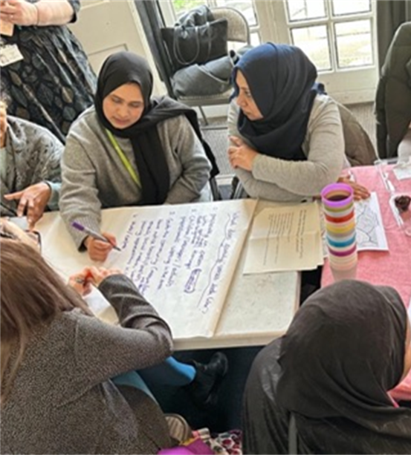



Family Voices
We are required as part of the Programme to have Parent Carer Panels (PCP’s), in Birmingham we have named these Family Voices
They are focused on the period from pregnancy to age 2, these panels are allowing families to share their views and experience on the design and delivery of Family Hubs and Start for Life services. By involving families in the design, we are shaping the offer and continually improving services to meet local families’ wants and needs
Family Voices brings parents and carers together with local service leaders to shape family services, this inclusive initiative ensures families are central to designing and improving Family Hubs.
They have been established in each of the 10 Localities with insights gathered and shared with the Operational Leads and Steering Groups so they can shape local service design, planning and delivery – a focus of this coming year is to increase engagement, strengthen the feedback loop and demonstrate examples of co-production
As part of the wider Family Voices network we are focusing upon a joined-up network of parents and families across the city for 0-19/25 for SEND, linking in with Maternity Voices and SEND Parent Carer Forum
FAMILY VOICES

Slide 11

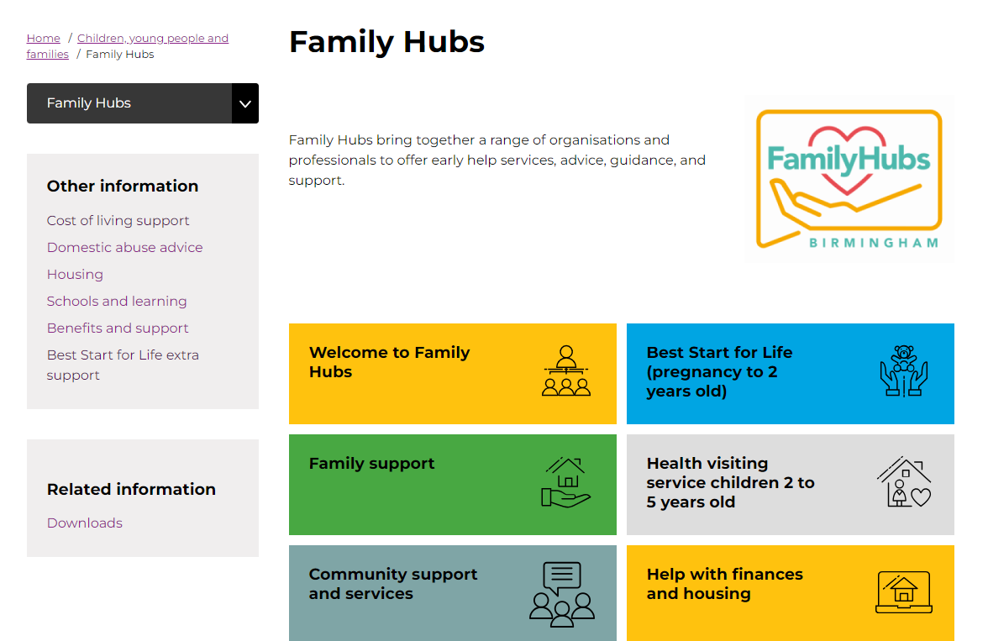
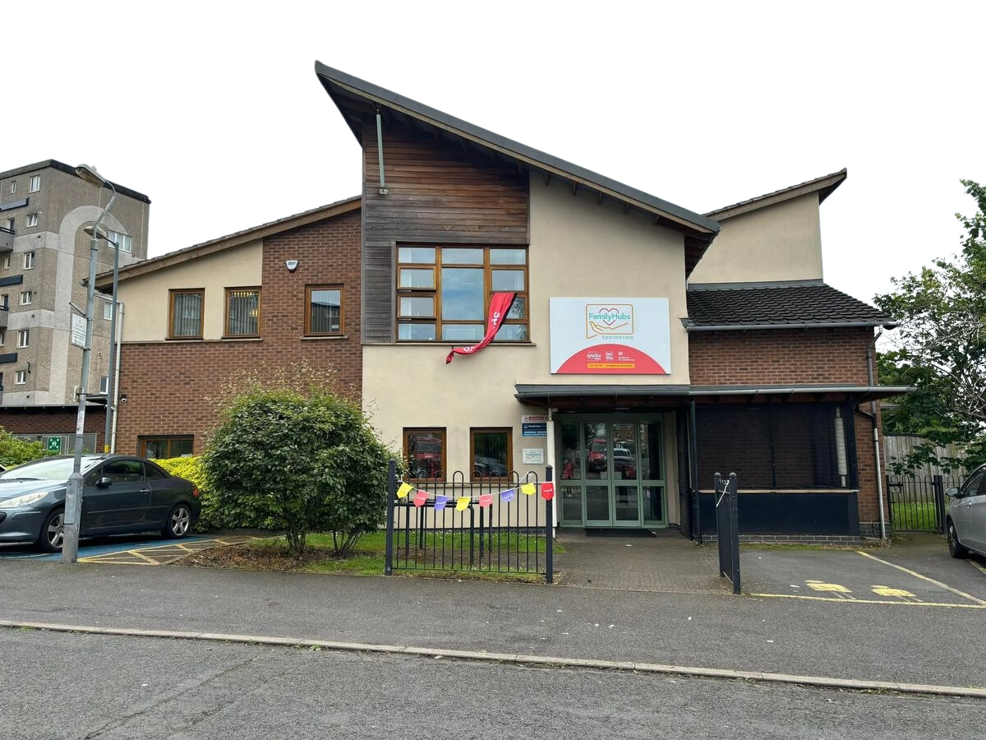

To find out more
Follow us on Facebook
Birmingham City Council Website – Family Hubs
Email us
familyhubs@birmingham.gov.uk
Find your local hub
http://bit.ly/BhamFamilyHubsMap

